Slide 1
TA’s Feedback for HW1
TA: WANG Cong cong_wang@sutd.edu.sg
WANG Peng peng_wang@sutd.edu.sg

Slide 2
Some common issues
Most of you guys have done a great job. But there are some submissions that are a little difficult for TA to understand. If possible, please use Word.
The maximum point is 10. The grading standard is that if you give wrong answer for calculation question, we will subtract 0.5 point. For instance, if you give a wrong answer for 6.1, you will lose 0.5 point. And for other questions, if your answer is not sufficient, TA will deduct 0.1-0.5 points depending on your answer. For late submissions, we will also deduct some points depending on duration from the deadline to the date when you submit the HW.

Slide 3
4. (textbook problem chapter 2, problem 4)
GET /cs453/index.html HTTP/1.1<cr><lf>Host: gaia.cs.umass.edu<cr><lf>User-Agent: Mozilla/5.0 (Windows;U; Windows NT 5.1; en-US; rv:1.7.2) Gecko/20040804 Netscape/7.2 (ax) <cr><lf>Accept:ext/xml, application/xml, application/xhtml+xml, text/html;q=0.9, text/plain;q=0.8, image/png,*/*;q=0.5<cr><lf>Accept-Language: en-us,en;q=0.5<cr><lf>Accept-Encoding: zip,deflate<cr><lf>Accept-Charset: ISO-8859-1,utf-8;q=0.7,*;q=0.7<cr><lf>Keep-Alive: 300<cr><lf>Connection:keep-alive<cr><lf><cr><lf>
a. What is the URL of the document requested by the browser?
The document request was http://gaia.cs.umass.edu/cs453/index.html.
The Host: field indicates the server's name and /cs453/index.html indicates the file name.
d. What is the IP address of the host on which the browser is running?
This is a trick question.
This information is not contained in an HTTP message anywhere.
So there is no way to tell this from looking at the exchange of HTTP messages alone.
One would need information from the IP datagrams (that carried the TCP segment that carried the HTTP GET request) to answer this question.

Slide 4
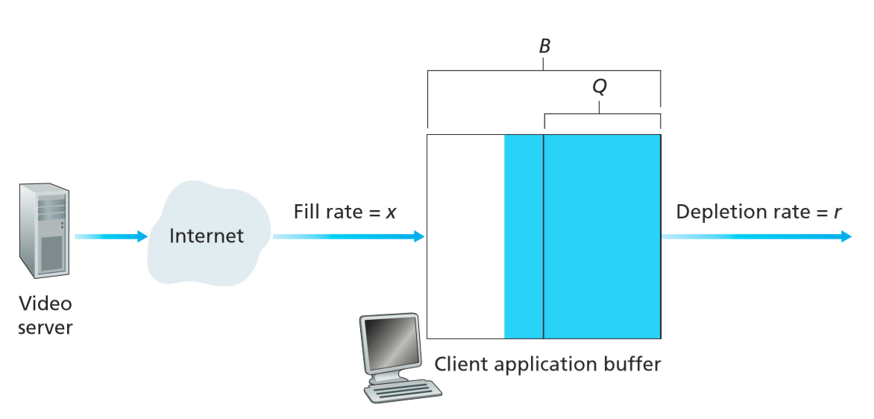
6. Recall the simple model for HTTP streaming shown in the Figure below. Let B denote the size of the client’s application buffer, and let Q denote the number of bits that must be buffered before the client application begins playout. Also, let r denote the video consumption rate. Assume that the server sends bits at a constant rate x whenever the client buffer is not full.
6.2 Now suppose that x > r. At what time does the client application buffer become full?
Time until buffer has Q bits is Q/x seconds.
Time to add additional B - Q bits is (B - Q)/(x - r) seconds.
Thus the time until the application buffer becomes full is Q/x + (B - Q)/(x - r) seconds.

